Slide 1
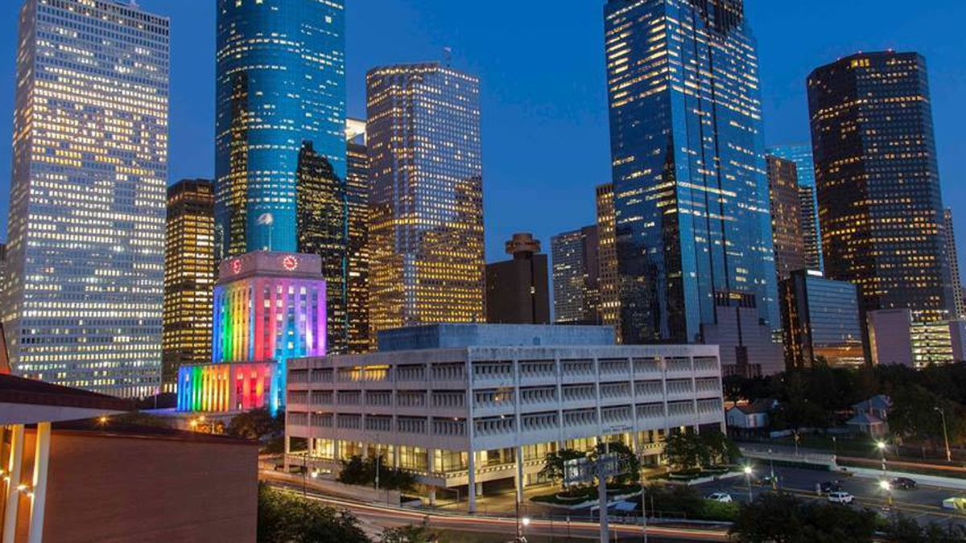
COURSERA CAPSTONE IBM APPLIED DATA SCIENCE CAPSTONE
Setting up an Indian Vegetarian Restaurant in Houston, TX, USA
SWAPNIL NAIK
Dallas, TX
DEC 2020

Slide 2
BUSINESS PROBLEM
• Location of the Indian Vegetarian Restaurant in a US City is one of the most important decisions that will determine whether the Restaurant will be a success or a failure.
• Objective: To analyse and select the best locations in the city of Houston,TX to open a new shopping mall.
• Business question
➢Which part and neighborhood of Houston should my friend open an Indian Vegetarian Restaurant.

Slide 3
DATA
• Data required
➢List of neighbourhoods in Houston
➢Latitude and longitude coordinates of the neighbourhoods
➢Venue data, particularly data related to Vegetarian restaurants
• Sources of data
➢Wikipedia page for neighbourhoods
(https://en.wikipedia.org/wiki/List_of_Houston_neighborhoods)
➢Geocoder package for latitude and longitude coordinates
➢Foursquare API for venue data

Slide 4
METHODOLOGY
• Web scraping Wikipedia page for neighbourhoods list
• Get latitude and longitude coordinates using Geocoder
• Use Foursquare API to get venue data
• Group data by neighbourhood and taking the mean of the frequency of occurrence of each venue category
• Filter venue category by Vegetarian Restaurants
• Perform clustering on the data by using k-means clustering
• Visualize the clusters in a map using Folium

Slide 5
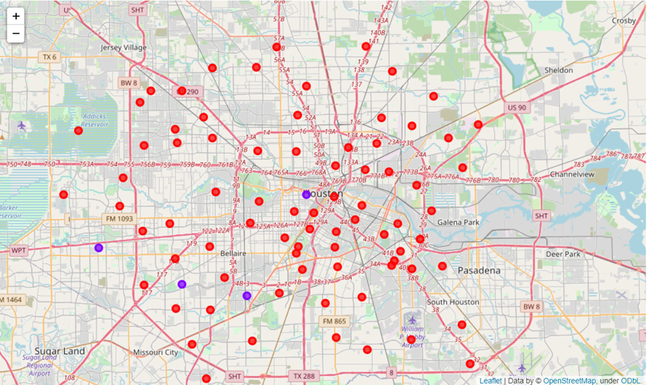
RESULTS
• Categorized the neighbourhoods
into 2 clusters :
➢Cluster 0: Neighbourhoods with
very less/nil number of shopping malls
➢Cluster 1: Neighbourhoods with
Some concentration of Vegetarian Restaurants

Slide 6
DISCUSSION
As observations noted from the map in the Results section, the Vegetarian/Vegan Restaurants are very sparsely concentrated in the southwest area of Houston city, with the higher number in cluster 1and moderate number in cluster 0 . This represents a great opportunity and high potential areas to open new Vegetarian/Vegan Restaurants as there is very little to no competition from existing establishments. Meanwhile, Vegetarian/Vegan Restaurants in cluster 1 are likely suffering from more competition due to oversupply and high concentration of Vegetarian/Vegan Restaurants. From another perspective, the results also show that the oversupply of Vegetarian/Vegan Restaurants mostly happened in the suburb area of the city, with the central area still have very few Vegetarian/Vegan Restaurants. Therefore, this project recommends my friend to capitalize on these findings to open new Vegetarian/Vegan Restaurants in Neighborhoods in cluster 0 with little to no competition.

Slide 7
RECOMMENDATIONS
• Open new Indian Vegetarain Restaurant in neighbourhoods in cluster 0 with little to no competition
• Can also open in neighbourhoods in cluster 1 with moderate competition if have unique selling propositions to stand out from the competition,as the concentration is stil sparse

Slide 8
CONCLUSIONS
• Answer to business question: The neighbourhoods in cluster 0 are the most preferred locations to open a new shopping mall
• Findings of this project will help the relevant stakeholders to capitalize on the opportunities on high potential locations while avoiding overcrowded areas in their decisions to open a new Indian Vegetarian restaurant.

Slide 9
THANK YOU!

